Slide 1

McDonald's Sales Performance & Customer Behavior Analysis
Analyzing historical sales data to uncover insights into customer purchasing patterns, menu item popularity, and revenue generation.
Performed By :- Divyansh Borana

Slide 2
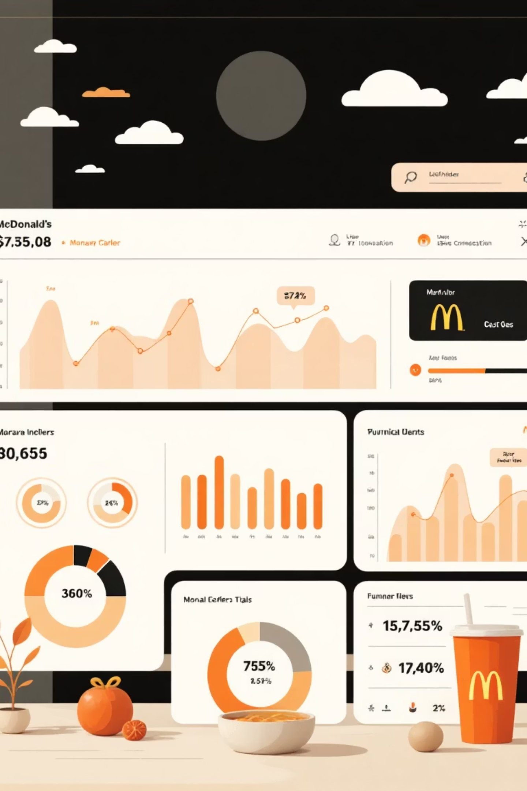
Project Overview
Project Description
Integrating Menu Items and Order Details datasets to evaluate product growth drivers and identify peak operational periods.
Data Scope
Covers over 12,000 individual item sales across 5,300+ unique orders from Q1 2023.

Slide 3
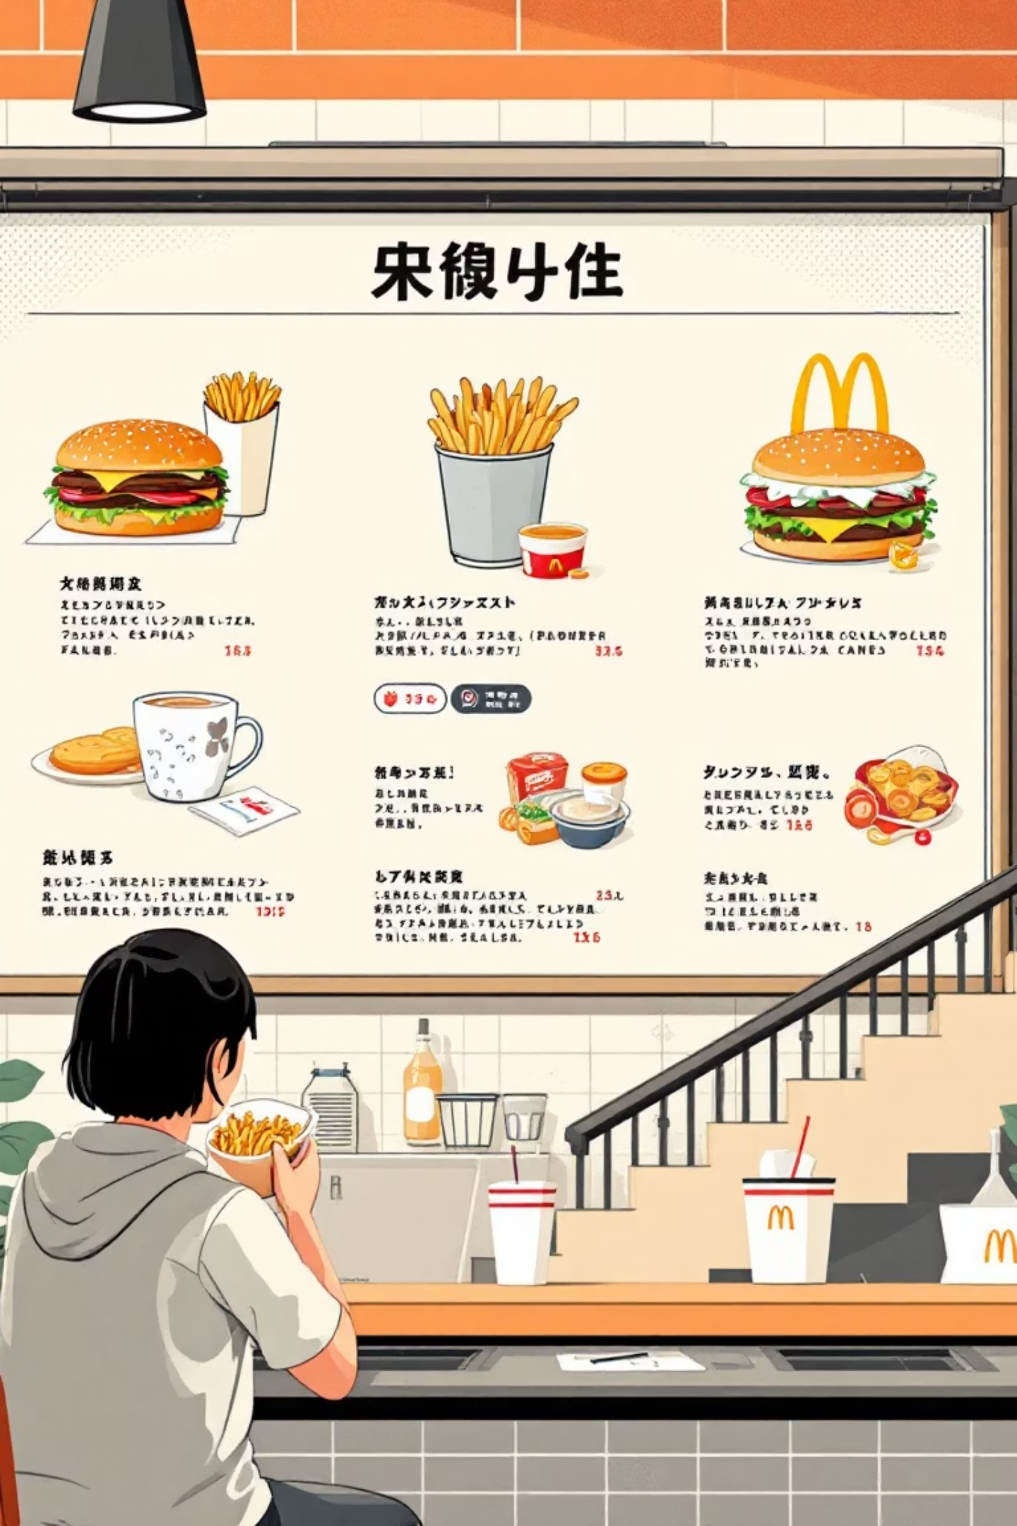




Essential Project Components
Revenue Analysis
Calculate total sales and identify highest revenue-generating categories.
Product Popularity
Determine most frequently ordered items to optimize inventory.
Customer Behavior
Analyze peak ordering times for staff scheduling.
Category Performance
Compare profitability of different food groups.

Slide 4


Dataset Overview
Menu Dataset
Order Details Dataset
menu_item_id
order_id
item_name
order_date
category
order_time
price
item_id

Slide 5

Key Insights (Preliminary Results)
$61,003.78
5
$21,000+
Top Popular Items
Total Revenue
Big Mac, Side Salad, Bulgogi Burger, Quarter Pounder, French Fries (Large).
Leading Category
Generated in Q1 2023.
Burgers are the primary revenue driver.

Slide 6

Methodology Workflow
01
02
Data Cleaning
Data Integration
Handle missing values and convert data types (date, time).
Merge datasets on unique item ID for a master sales record.
03
04
Exploratory Data Analysis (EDA)
Time-Series Analysis
Visualize sales trends using charts and graphs.
Aggregate sales by hour and day to identify busy periods.

Slide 7

Strategic Recommendations
Inventory Optimization
1
Ensure high stock levels for top sellers like "Big Mac" and "Side Salad."
Marketing Focus
2
Promote "Bulgogi Burger" with bundles due to its popularity.
Operational Efficiency
3
Increase staffing during peak hours (e.g., 12:00 PM - 2:00 PM) to reduce wait times.

Slide 8

Data Understanding & Requirement Gathering
The initial step involves identifying available data and project needs.
Menu Data: Provides item names, categories, and prices.
Order Data: Offers transaction dates, times, and order groupings.
Our goal is to connect these datasets to determine profitable items and active customer periods.

Slide 9


Data Cleaning & Integration
Data Cleaning
Data Integration
Handle missing values, correct data types (date, number), and standardize category names.
Perform a Left Join using item_id to combine menu and order details, enabling revenue calculation per transaction.

Slide 10
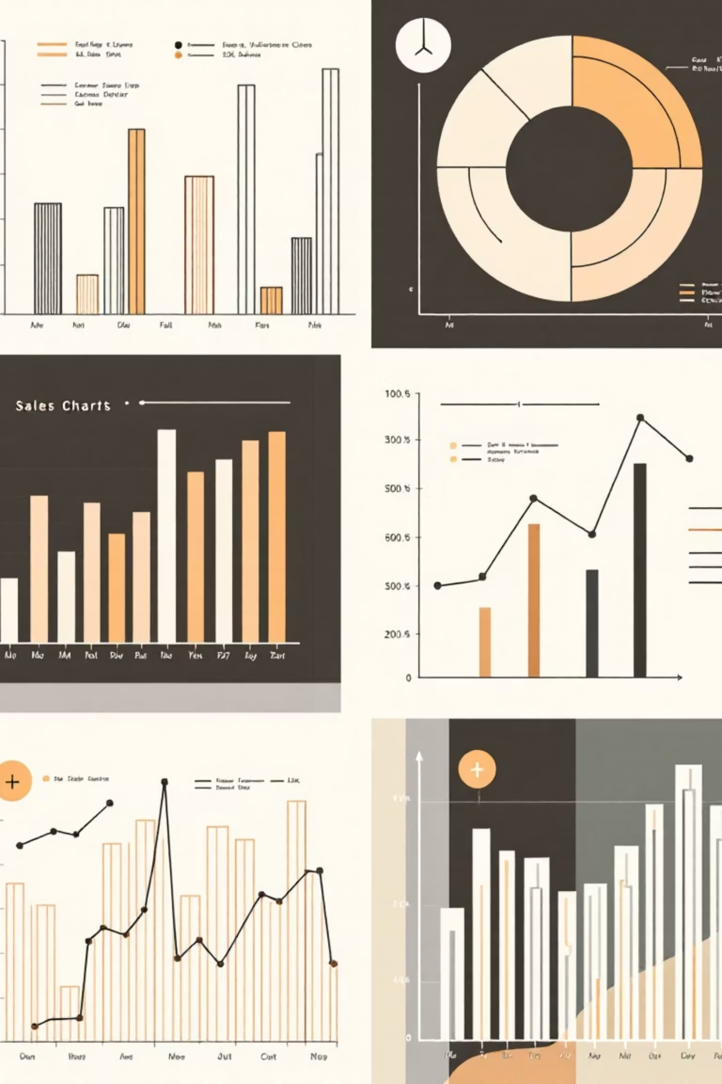
Exploratory Analysis & Visualization
1
EDA: Discovery Phase
Calculate key metrics like sales volume, item value, and identify sales trends (e.g., weekend vs. weekday).
2
Data Visualization
Transform numbers into visual stories using bar charts for category performance, pie charts for market share, and line graphs for sales peaks.

Slide 11
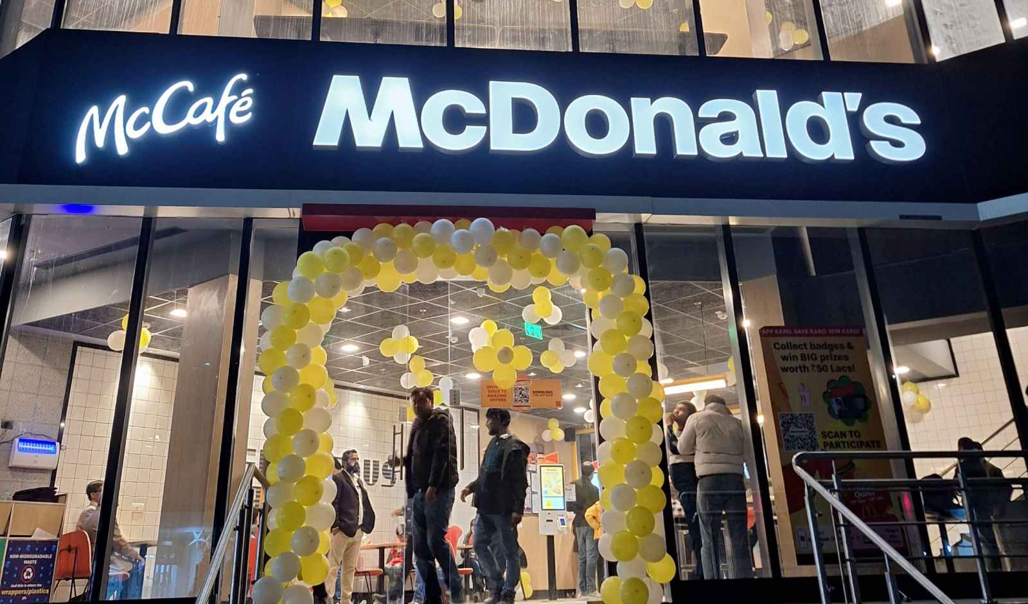
Performance in video format :-
https://drive.google.com/drive/folders/1c-_iIon9Y6FgBXDjl_ULb3p1_8CS0gmK?usp=drive_link

